Slide 1

CIS 505 :
TEAM ASSIGNMENT
Team – 22193 Name – DATA LORDS
Team Members
Kexin Geng
Sahil Mehta
Sarthak Bairiganjan
Lynda Jennith Vijayakumar
Raja Shekher Reddy

Slide 2
BUSINESS OVERVIEW
Background, Objective
Birds strikes with aircraft are increasing in the United States. The incidents have big safety and financial impact on society and airlines. It is said that Bird and other wildlife strikes to aircraft cause an estimated $900+ million in damage to U.S. civil and military aircraft annually. Therefore, it is necessary to figure out the main factors that related to the bird strikes based on the data we have.
Business Requirements
Is the reported number of bird strikes increasing or decreasing?
When do most accidents happen? What time of day is it?
Is the weather and sky a factor in the bird strike accident?
Location where bird strikes are more common?
Are the accidents caused by specific birds? At what altitude do the accidents occur?
During which stage of the journey do accidents occur?
Cost analysis due to bird strike damage
Which operator is spending the most out of service hours on an aircraft?
Analyzing which state is most vulnerable during different phases of flight?
Approach
Landing Roll
Take of Run

Slide 3
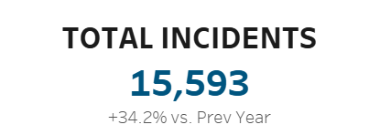
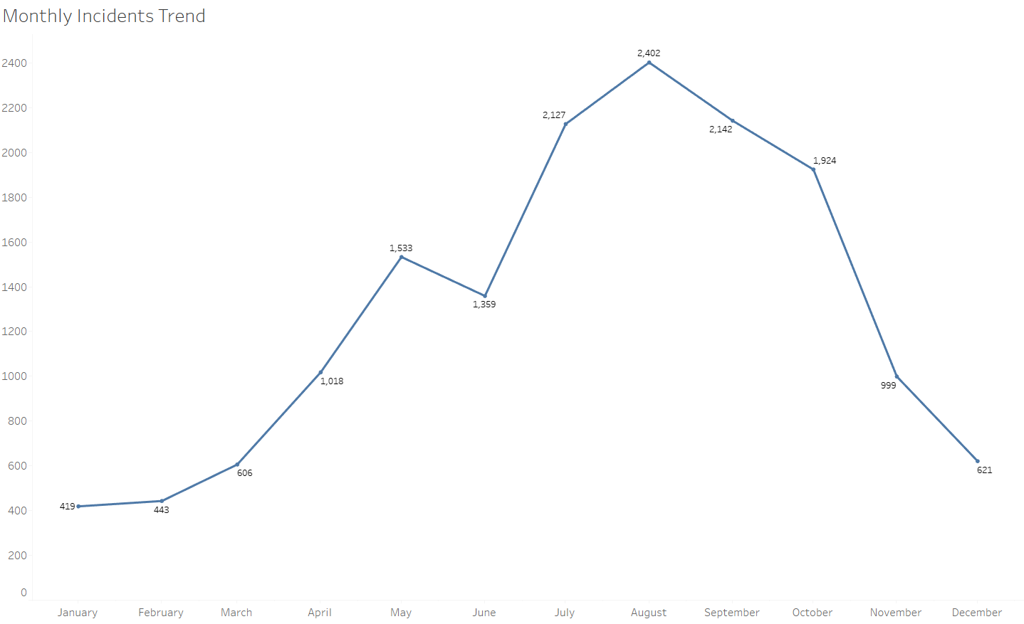
INCIDENTS OVER TIME
In 2021, there was an increase in bird strike cases by 34% compared to previous year.
Bird strike incidents have been increased from 11,620 cases to 15,593 cases.
During Fall season, number of incidents increase drastically, and this might be due to birds migrating from one place to another.

Slide 4
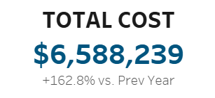
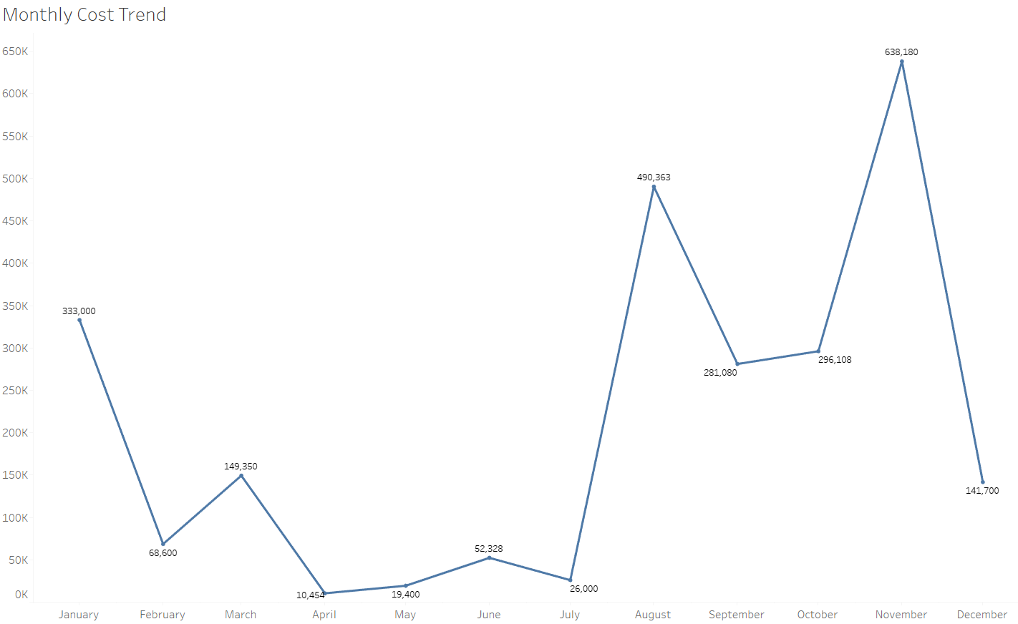
COST DUE TO INCIDENTS
Cost incurred due to bird strikes was increased by 168% in 2021
There was significant increase in total cost incurred from $2.5M to $6.5M.
* Total Cost include cost of repairs and other costs

Slide 5
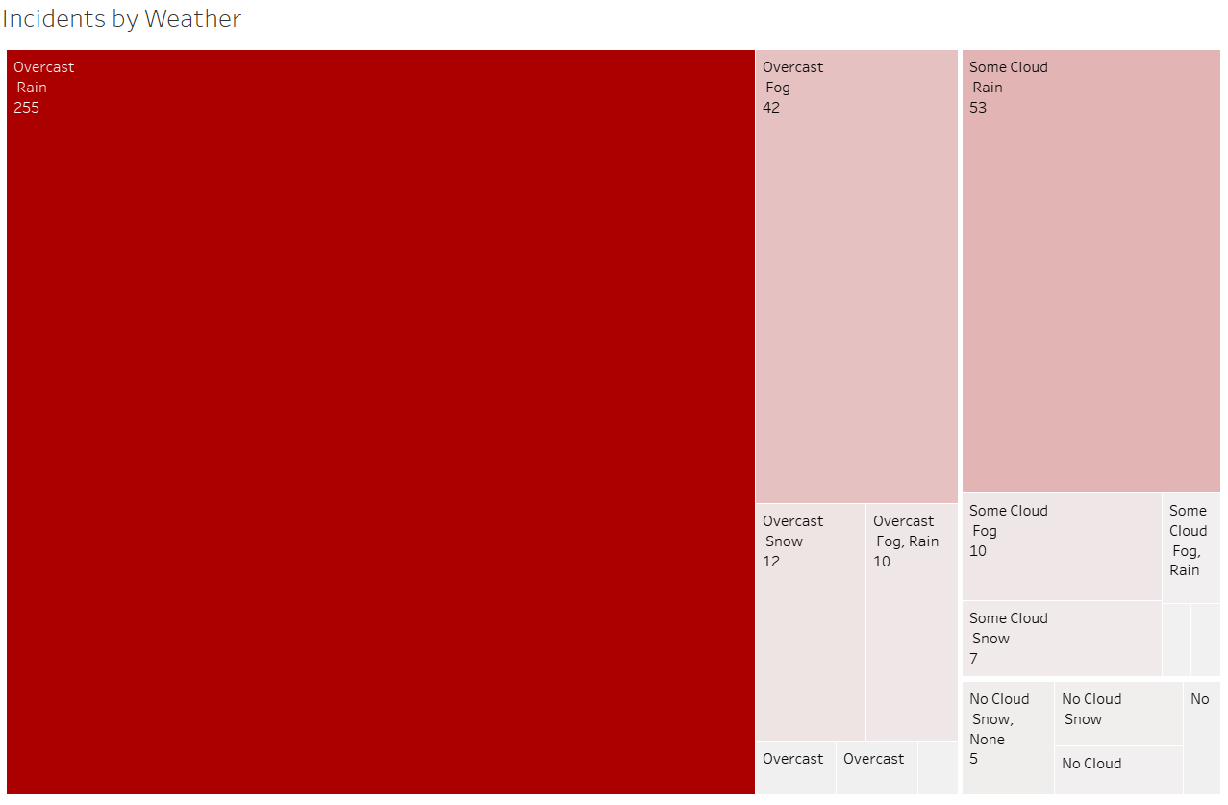
EFFECT OF WEATHER ON INCIDENTS
Weather plays a key role in analyzing the cause of aircraft accidents as it can been seen that:
If the sky is cloudy, then there are around 350 accidents as it makes the visibility very poor.
It's a cloudy day when the number of bird strike incidents is highest, the most common weather condition for incidents is rain or fog.
Recommendations:
Delay the flights if the visibility is beyond the threshold limit.
Strict government regulations should be implemented to avoid the accidents
Improve the flight technologies to avoid accidents

Slide 6
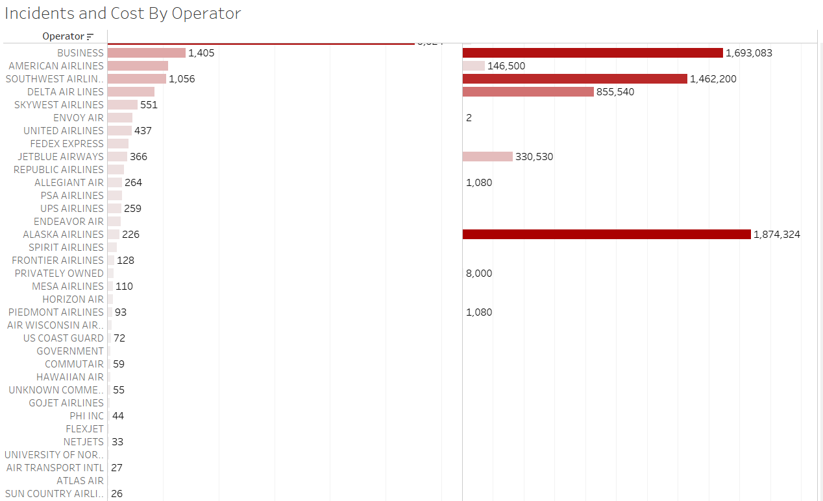
INCIDENTS AND COST BY OPERATOR
Southwest airline, American airline and business aircrafts are the operators which are most struck by birds.
All of the above 3 operators have faced more than 1000 bird strike cases in 2021
In 2021, the cost incurred by Southwest airline and business aircrafts is around $1.5M.
Alaska airlines have faced fewer incidents, however the cost associated with the incidents is maximum. The cost to repair is around $1.8M in Alaska.
Recommendations:
Invest in flight technologies to avoid accidents and government penalties.

Slide 7
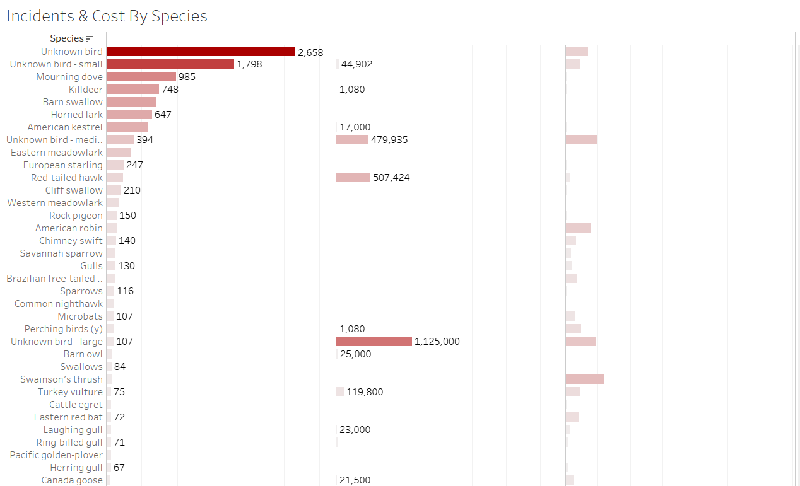
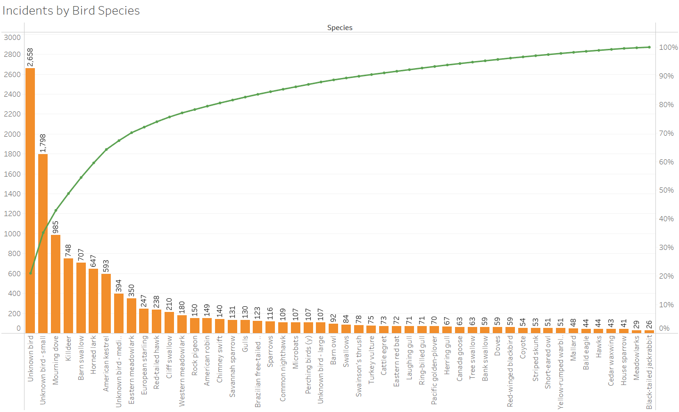
INCIDENTS BY SPECIES
Most of the incidents have occurred due to Small birds (1,798 cases), mourning dove(985 cases) and killdeer(748 cases).
Cost incurred by the operators due to accidents from small birds is very minimal.
The cases due to bald eagles are very few (44 cases), however the cost of repairs is significantly large ($2.5M).
80% of total incident cases are due to 20% (approx.) of the wildlife species from which bird strikes are encountered.
Recommendations:
Focus on reducing the cases from the 20% of the wildlife species.
Improve technologies to control bird population on airbase.

Slide 8
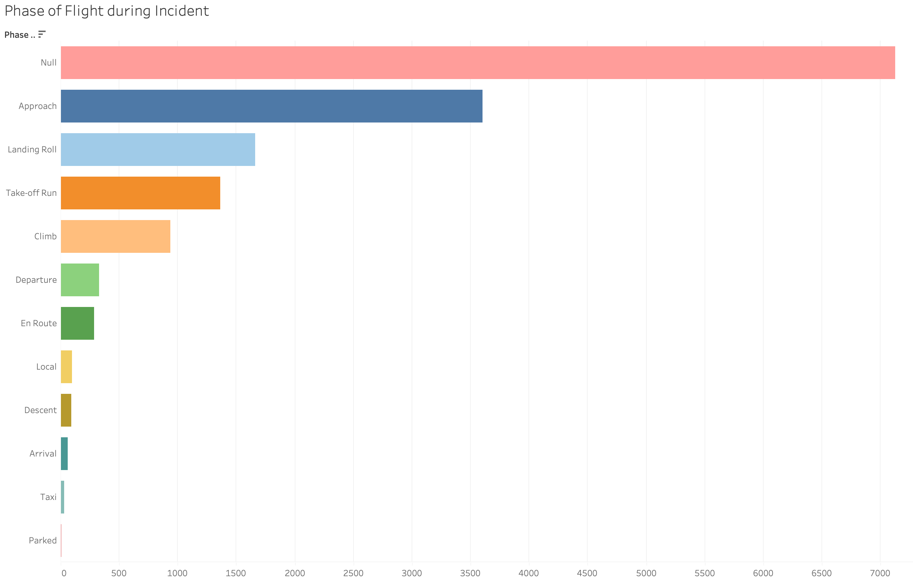
INCIDENTS BY PHASE OF JOURNEY
The top three phases of flight during which strike mostly occurred are : Approach, Landing Roll and Take-off Run (except ”Null”).
The value of incidents occurred in these phases are 3,603, 1,660, 1,365 respectively.
The reason for that might be the heights of flight in these phase are quite low and easier for birds to reach. Therefore, some control methods should be taken when the airplane is in these phases.
3,603

Slide 9
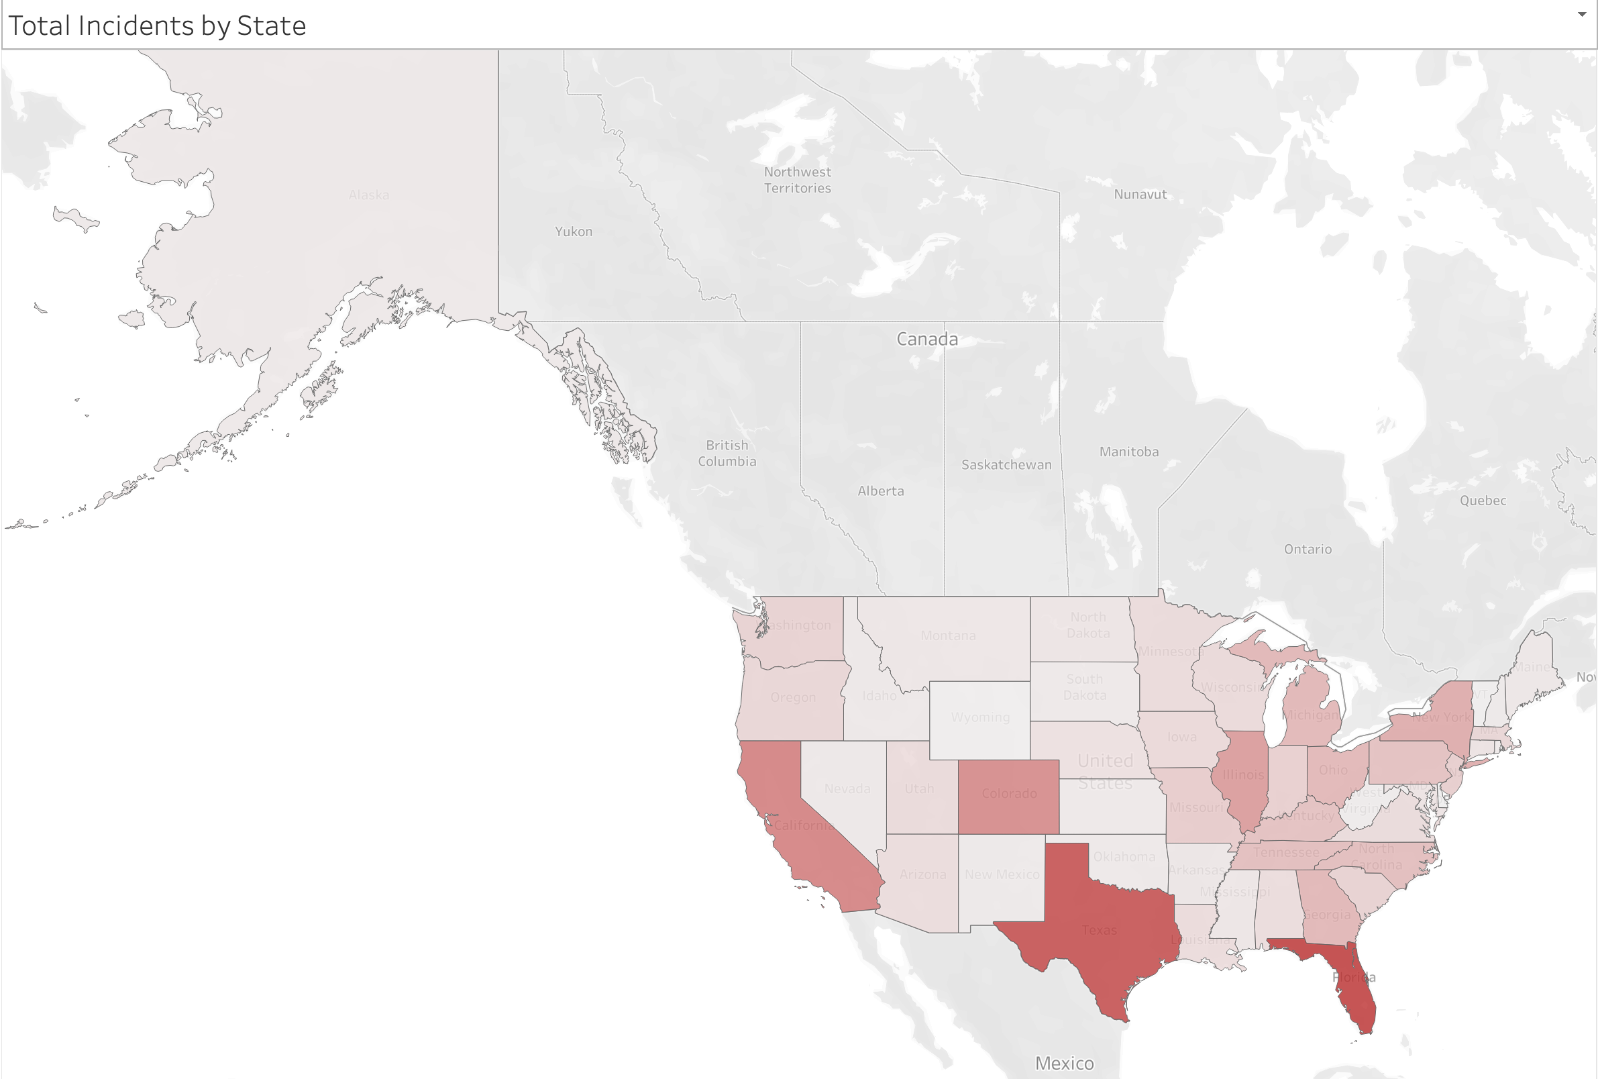
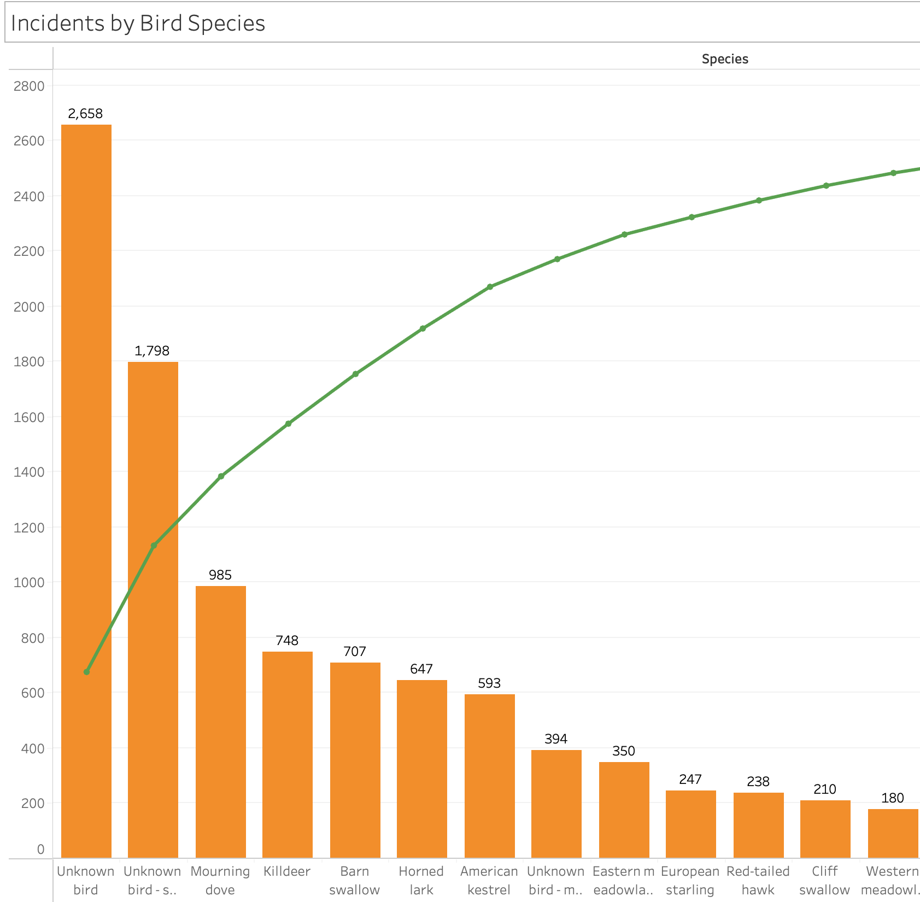
BIRD STRIKES BY LOCATION
The top three locations of bird strikes commonly occurred are : Florida, Texas and California.
The value of incidents occurred in these locations are 1,499, 1,339, 897 respectively.
We combine this results with the results of incidents by bird species and interestingly found that Mourning doves are the most species occurred in bird strikes. According to the paper, Mourning doves are the most widely distributed and only native species of dove in Florida.
(Sourcing:https://edis.ifas.ufl.edu/pdf%5Carchived%5CUW%5CUW267%5CUW267-16063243.pdf)
897
1,339
1,499

Slide 10
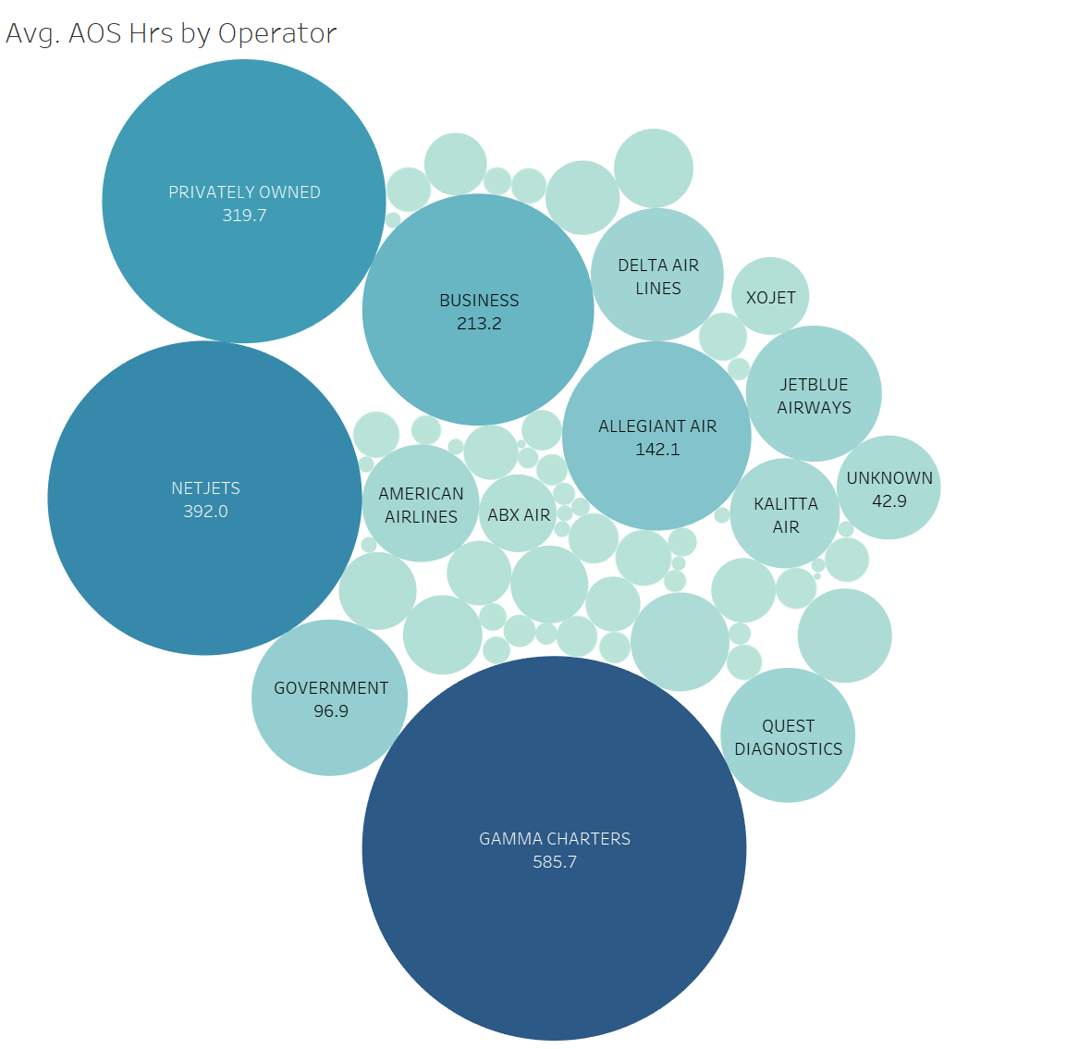
OPERATOR VS AOS ANALYSIS
Objective is to analyze which operator suffers the most by comparing the AOS.
AOS stands for “Aircraft Out Of Service”.
The data being used to create the charts has AOS in “Hours”. Therefore, for high level synopsis we will see which operator’s spend more than 5 days on fixing an operator which is roughly more than 120 hours.
As we can observe, the size of the circle determines the number of days spent to fix the aircraft and top 4 operators that spent most time fixing are –
Gamma Charters (24 days)
NetJets (16 days)
Privately owned operator (13 days)
Business (8 days)
Recommendations:
These 4 operators should fix their maintenance system and try to implement support as other airlines like “Delta Air Lines” because their fixing time is less than 3 days.

Slide 11
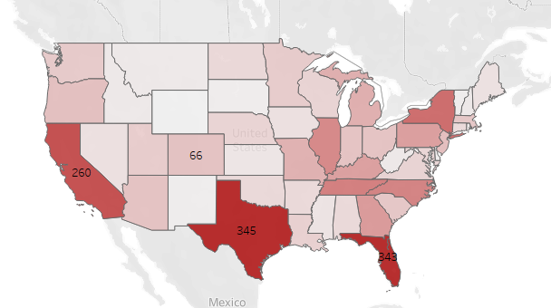
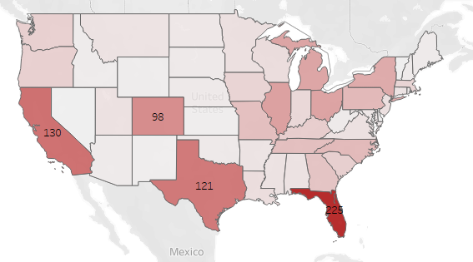
STATE VS PHASE OF FLIGHT ANALYSIS
We are trying to figure out which Phase of flight is affected most in particular states.
There are three phases of flight that are being mostly effected by bird strike:
Approach
Landing Roll
Take-Off Run
When we toggle in “Summary” dashboard to “Approach” we can see state “Texas” is effected the worst.
Florida is adversely effected by birdstrike when aircrafts are in “Landing Roll” phase.
Again, Florida is effected when the plane is completing it’s “Take-Off” Run phase.
Recommendations:
Business should prioritize on the above states and fix these phases of flight because they suffer the most.
Incidents by State - Approach
Incidents by State – Landing Roll

Slide 12
DASHBOARD SCREENSHOTS

Slide 13
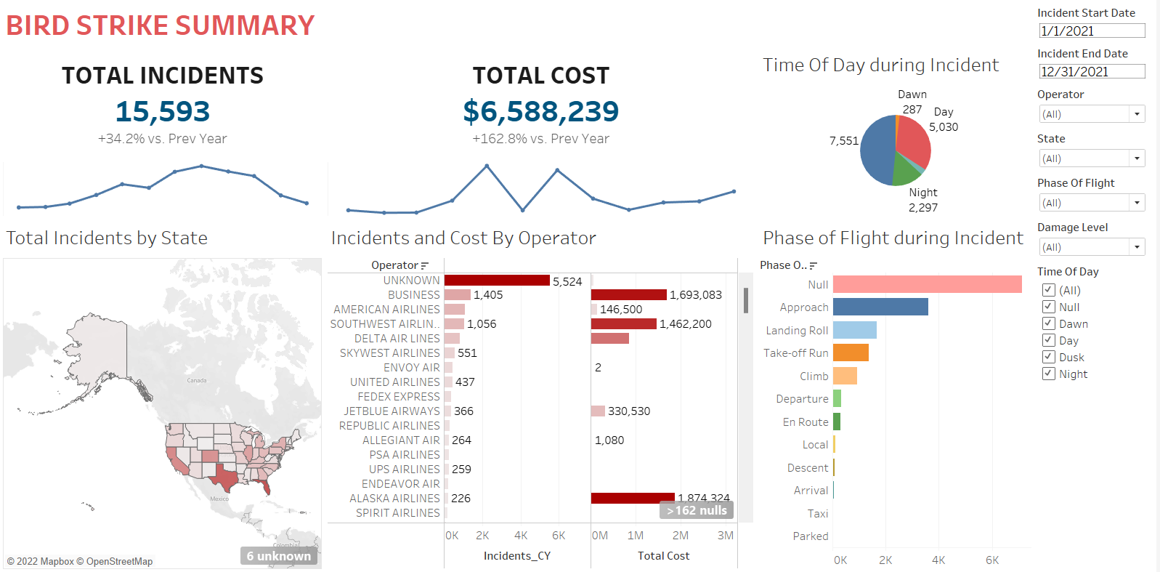

Slide 14
